Slide 1
Last Lecture: Putting it Together
CS 118: Computer Networks
George Varghese
(some slides from Alex Snoeren)

Slide 2
Exam Overview
Focus on topics since the midterm
Very little on earlier lectures, a few small basic questions…
Roughly the same style, as midterm, maybe 7-8 questions instead of 5
It won’t take the whole time
We’ll do a full exam review next lecture
Will post a sample final as well (two different old finals)
As with the midterm, you can bring crib sheet
One double-sided 8x5.x11” paper that you turn in

Slide 3
Network complexity conquered by abstractions
Abstractions are idealizations we invent to deal with the perversity and complexity of reality. We use them all the time to deal with the complexity of the world around us. Examples include
Models in Physics: We abstract planets as point masses interacting via gravitation to predict orbits ignoring different compositions, shapes, other forces etc.
Music: We abstract the complexity of music (tone, timber) using notes
Math: We abstract matrices and numbers as fields ignoring their differences.
Computer Science: We would like to hide the messy details of computer and networks from programmers to make them more productive by hiding implementation details behind a programming interface.

Slide 4
Just as in OSes which abstract a computer
Create clean abstractions so that application programmers on say Windows OS can write large programs quickly and correctly. Examples include
Processes: Abstraction of Uninterrupted Computation: Dealing with idiosyncrasies of interrupts would be intolerable.
Virtual Memory: Abstraction of Infinite Memory: Dealing with the details of moving data from disk to memory would be a pain
Simple I/O: Abstracting devices Dealing with the idiosyncrasies of various devices (USBs, cameras, microphones) would be hard.
simpler illusion of reading and writing devices from memory

Slide 5
Abstractions require underlying
mechanisms
Process P1 runs to completion all by itself
ILLUSION
ILLUSION
Time Line
P1 start
On interrupt, kernel saves P1’s state
Scheduler runs Pick
P2
P2’s state is restored
P2 runs
. . . .
P1 runs again and finishes
REALITY
Underlying mechanisms: Context switch, scheduling, protection

Slide 6
These are our network abstractions
Copy File F at S
to File F at D
S
R1
R2
D
User Interface
Write (m) to connection queue
Read (m)
Transport (TCP)
Interface
^{F}6-8 | ^{F}2-5 | F₁
Send (segment) to D
Receive (segment)
Routing (IP) Interface
S
R1
R2
D
other paths?
Send (packet)
Receive (packet)
Data Link Interface
R1
R2
Send (bit)
Receive (bit)
Physical Layer Interface

Slide 7
Mechanisms within each abstraction
TRANSPORT LAYER:
MULTIHOP PACKET PIPE
Same as Data Link Congestion Control
NETWORK LAYER: PACKET SWITCH
Addressing
Routing Forwarding
DATA LINK LAYER:
1−HOP FRAME PIPE
Error Detection
Framing
Error Recovery Flow Control
Taking Turns
Extending Data Links
PHYSICAL LAYER: BIT PIPE
Clock Recovery
Multiplexing
Media
13

Slide 8
SIMILAR ABSTRACTIONS USED BY SOCIETY
_{HAZELS} "3 Shipments of Plumed Hats"
HAZELS
HATS
"Check Inventory"
MOROCCO
BOSTON
BIGWIG IMPORT
BIGWIG
"Did shipment arrive?"
MOROCCO
EXPORT
"Whoa, too fast"
BOSTON
RIO
MOROCCO
POST
POST
POST
OFFICE
OFFICE
OFFICE
VARIG
VARIGB.S.
CASABLANCA
AIR
RIO RIO
BALLOON STATION
_{(LOGAN)} Airline
Balloon

Slide 9
The Protocol Stack
host
host
Application Layer
HTTP
HTTP
Transport Layer
TCP
TCP
router
router
Network Layer
IP
IP
IP
IP
Link Layer
Ethernet
interface
Ethernet
interface
SONET
interface
SONET
interface
Ethernet
interface
Ethernet
interface

Slide 10
Encapsulation via Headers
Typical Web packet
Notice that layers add overhead
Space (headers), effective bandwidth
Time (processing headers, “peeling the onion”), latency
Ethernet Hdr
IP Hdr
TCP Hdr
HTTP Hdr
Payload (Web object)
datalink
network
transport
application
Start of packet
End of packet

Slide 11
Quick Review of Layers
In the course we went bottom up from physical to transport
Lets now review top down just as we started in first lecture
From DNS down to the physical layer, but by now we’ve learned a lot

Slide 12
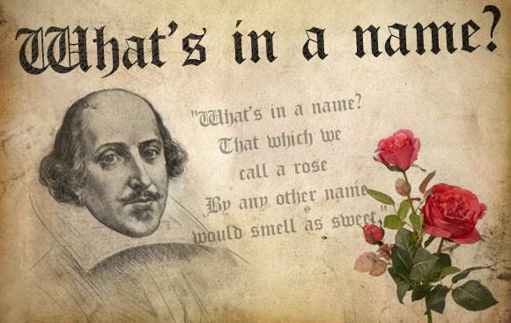
DNS Review: From user friendly names to IP addresses

Slide 13
DNS Abstraction
Host at cis.poly.edu wants IP address for gaia.cs.umass.edu
Ask local DNS server
dns.poly.edu

Slide 14
DNS Mechanisms in Reality
Host at cis.poly.edu wants IP address for gaia.cs.umass.edu
root DNS server
2
3
TLD DNS server
4
local DNS server
dns.poly.edu
5
7
6
1
8
requesting host
cis.poly.edu
authoritative DNS server
dns.cs.umass.edu
gaia.cs.umass.edu

Slide 15

Transport Layer Review
Write (m) to connection queue
Read (m)
(TCP)
^{F}6-8 | ^{F}2-5 | F₁

Slide 16
TCP Abstraction
Application process
Application process
W
rite
Read
…
bytes
…
bytes
TCP
TCP
Send buffer
Receive buffer
ILLUSION
Transmit segments
…
REALITY
Segment
Segment
Segment

Slide 17
TCP Mechanisms
3-way handshake using ISN to defend against delayed duplicates
Sliding Window for reliability
Flow and congestion control by dynamically adjusting window

Slide 18
Basic TCP Algorithm
Window-based congestion control
Unified congestion control and flow control mechanism
rwin: advertised flow control window from receiver
cwnd: congestion control window
Estimate of how much outstanding data network can deliver in a round-trip time
Sender can only send MIN(rwin,cwnd) at any time
Idea: decrease cwnd when congestion is encountered; increase cwnd otherwise

Slide 19
TCP is a Sliding Window Protocol
Sender
Receiver
1
cwnd=1
Ack 2
2
cwnd=2
3
Ack 3
Ack 4
4
cwnd=4
5
Ack 5
6
Ack 6
7
Ack 7
Ack 8
cwnd=8

Slide 20
TCP CONGESTION CONTROL SUMMARY
S
D
10
1
Linear
Fast Retransmit
threshold
Timeout
Window
(cwnd)
Slow Start
Time

Slide 21
Socket Interface to Abstraction
P1
P2
P2
P1 Transport
Transport
socket
socket
sockfd
bind listen
bind
connect P2
accept
send
rcv

Slide 22
Transport Protocol Ideas
IDEAS
TRANSPORT MECHANISMS
Just like reliable Data Links except
Error Control, Sequencing
Multiple connections, larger
sequence numbers
_{Fault−tolerance} Connection Management
3−way handshakes, Timer−based Management
Graceful disconnection
Delayed duplicates
Crashes
2 generals
Adaptive Protocols Passing info in
Congestion Control
Matching to network speed
headers. Deadlock vs.
Livelock
Control vs. Avoidance Congestion Collapse Bit or timeout based
feedback.

Slide 23

Routing Review
Routing (IP)
Send (segment) to D
Receive (segment)
S
R1
R2
D

Slide 24
Routing Challenges
How to choose best path?
Defining “best” can be slippery
How to scale to millions of users?
Minimize control messages and routing table size
How to adapt to failures or changes?
Node and link failures, plus message loss

Slide 25
Forwarding Options
Source routing
Complete path listed in packet
Virtual circuits
Set up path out-of-band and store path identifier in routers
Local path identifier in packet
Destination-based forwarding
Router looks up address in forwarding table
Forwarding table contains (address, next-hop) tuples

Slide 26
Mechanism: Link-state Routing
Two phases
Reliable flooding
Tell all routers what you know about your local topology
Path calculation (Dijkstra’s algorithm)
Each router computes best path over complete network
Motivation
Global information allows optimal route computation
Straightforward to implement and verify

Slide 27
Dijkstra’s Shortest Path Tree
So you have all of these LSPs. Now what?
Graph algorithm for single-source shortest path tree (find best route to all nodes, either prefixes or routers
P ← {} permanent set is empty
T ← <remaining nodes keyed by distance>
While T != {} while temp is not empty
u ← extract-min(T) u = node with lowest cost
P ← P plus {u}
Within T:
for each node v adjacent to u
“relax” the cost of v is it cheaper to go
through u?
← u is done

Slide 28
Mechanism: Distance Vector Algorithm
Iterative, asynchronous: each local iteration caused by:
Local link cost change
Distance vector update message from neighbor
Distributed:
Each node notifies neighbors when its DV changes
Neighbors then notify their neighbors if necessary
Each node:
wait for (change in local link cost or message from neighbor)
recompute estimates
if distance to any destination has changed, notify neighbors

Slide 29
Problem: Counting to Infinity
Distance to C
3
2
1
2
A
B
C
3
4
1
A
B
C
Update 3
5
4
1
A
B
C
Etc…
Update 4

Slide 30
Autonomous Systems
Internet is divided into Autonomous Systems
Distinct regions of administrative control
Routers/links managed by a single “institution”
Service provider, company, university, …
Hierarchy of Autonomous Systems
Large, “tier-1” provider with a nationwide backbone
Medium-sized regional provider with smaller backbone
Small network run by a single company or university
Interaction between Autonomous Systems
Internal topology is not shared between ASes
… but, neighboring ASes interact to coordinate routing

Slide 31
Inter-domain Routing
Border routers summarize and advertise their routes to external neighbors and vice-versa
Border routers apply policy
Internal routers can use notion of default routes
Core is default-free; routers must have a route to all networks in the world
But what routing protocol?
AS1
Border router
Border router
AS2

Slide 32

Mechanism 3: Path-vector Routing
Extension of distance-vector routing
Support flexible routing policies
Avoid count-to-infinity problem
Key idea: advertise the entire path
Distance vector: send distance metric per destination
Path vector: send the entire path for each destination
“d: path (2,1)”
“d: path (1)”
3
2
1
data traffic
data traffic
d

Slide 33
A Simple BGP Route
Destination prefix (e.g., 128.112.0.0/16)
Route attributes, including
AS path (e.g., “7018 88”)
Next-hop IP address (e.g., 12.127.0.121)
192.0.2.1
12.127.0.121
AS 7018
AT&T
AS 88
AS 11
Princeton
Harvard
128.112.0.0/16
AS path = 88
Next Hop = 192.0.2.1
128.112.0.0/16
AS path = 7018 88
Next Hop = 12.127.0.121

Slide 34
Business Relationships
Neighboring ASes have business contracts
How much traffic to carry
Which destinations to reach
How much money to pay
Common business relationships
Customer-provider
E.g., MIT is a customer of Level3
Peer-peer
E.g., UUNET is a peer of Sprint

Slide 35
Router architecture
Firewall
Reservation/
Admission
Control
Routing
Protocols
Control Plane
Complex
Per-control action
May be slow
Classification
Rules
Routing
Table
Forwarding
Table
Data plane
Simple
Per-packet
Must be fast
Packet
Classification
Switching
Output
Scheduling

Slide 36
Interconnect architecture
Input & output connected via switch fabric
Kinds of switch fabric
Shared Memory
Bus
Crossbar
How to deal with transient contention?
Input queuing
Output queuing
Input
Output
Switch

Slide 37
Routing Ideas
TIDEAS
ROUTING MECHANISMS
Flexible: Hierarchies
Scalability vs Efficiency
Addressing
Partition address to reflect
hierarchy.
Flexible Partition (IP masks) Unlimited levels (OSI)
Neighbor Greeting
_{Autoconfiguration}Send hellos to discover neighbor
Initialization Failures
and detect failure
Endnode Routing: must be simple Send to Router + Redirects
Connectionless Routing
Distance Vector: Similar to Spanning Tree except for Age Fields: Count to infinity.
Solved by limit on cost
Link State: Intelligent flooding
Forwarding
Stop Looping packets
Hop Counts,Time to Live
Post Office vs. Phone Model
Failure Methods
Crash Recovery
2 generals
Handle Diversity!

Slide 38
Data Link Review
Send (packet)
Receive (packet)
Data Link
R1
R2

Slide 39
Data Link Sublayers
Point−to−point Links (2 nodes)
(e.g., HDLC, Frame Relay)
Broadcast Links (>= 2 nodes)
(e.g., Ethernet, Token Ring)
Frames
Frames
ERROR RECOVERY
(OPTIONAL)
MULTIPLEXING
MEDIA ACCESS
ERROR DETECTION
ERROR DETECTION
FRAMING
FRAMING
Bits
Bits
QUASI-RELIABLE 1 HOP FRAME PIPE

Slide 40
Data Link Ideas
IDEAS
DATA LINK MECHANISMS
Point−to−point
Error Detection (CRCs and Parity)
Framing
Error Recovery:
Alternating Bit
Sliding Window Selective Reject
Flow Control
Correctness: Invariants Reduction
Performance
Initialization
Impossibility
Results
Performance:
LANs: Taking Turns
^{Ethernet}Collision Sense,
No Error
Recovery Randomization
802.5
Detection & Backoff
Extending Data
Layer n Relays
Link Protocols
Basic Bridging
Loop Detection Attempt
Protocol Design!
In Stages Failures
Autoconfiguration Self−stabilization
Spanning Tree

Slide 41
CSMA/CD
How can A know that a collision has taken place?
Worst case:
Latency between nodes A& B is d
A sends a message at time t and B sends a message at t + d – epsilon (just before receiving A’s message)
B knows there is a collision, but not A… A must keep transmitting until it can tell if a collision occurred
How long? 2 * d
IEEE 802.3 Ethernet specifies max value of 2d to be 51.2us
This relates to maximum distance of 2500m between hosts
At 10Mbps it takes 0.1us to transmit one bit so 512 bits take 51.2us to send
So, Ethernet frames must be at least 64B (512 bits) long
Padding is used if data is too small
Send jamming signal to insure all hosts see collision
48 bit signal

Slide 42
CSMA/CA
Cannot detect collision w/half-duplex radios
Wireless MAC protocols often use collision avoidance techniques, in conjunction with a (physical or virtual) carrier sense mechanism
Collision avoidance
Nodes negotiate to reserve the channel.
Once channel becomes idle, the node waits for a randomly chosen duration before attempting to transmit.

Slide 43
RTS/CTS (MACA)
A
B
C
When A wants to send a packet to B, A first sends a Request-to-Send (RTS) to B
On receiving RTS, B responds by sending Clear-to-Send (CTS), provided that A is able to receive the packet
When C overhears a CTS, it keeps quiet for the duration of the transfer
Transfer duration is included in both RTS and CTS

Slide 44
Physical Layer Review
Send (bit)
Receive (bit)
Physical Layer

Slide 45
PHYSICAL LAYER: SUBLAYERS
Input Stream Output Stream 01010000 01010000
Coding Sublayer
Decoding Sublayer
Coded Stream
Coded Stream
Media Transmission
Media Reception
Sublayer
Sublayer
Input Signal
Output Signal
Signal Transmission Sublayer
(SHANNON AND NYQUIST LIMITS)
3

Slide 46
Phy/(MAC)Link layer
Signal encoding
Encode binary data from source node into signals that physical links carry
Signal is decoded back into binary data at receiving node
Work performed by network adapter at sender and receiver
Media access
Arbitrate which nodes can send frames at any point in time
Not always necessary; e.g. point-to-point duplex links

Slide 47
Signals and Channels
A signal is some form of energy (light, voltage, etc)
Varies with time (on/off, high/low, etc.)
Can be continuous or discrete
A channel is a physical medium that conveys energy
Any real channel will distort the input signal as it does so
How it distorts the signal depends on the signal

Slide 48
Carrier Signals
Baseband modulation: send the “bare” signal
E.g. +5 Volts for 1, -5 Volts for 0
All signals fall in the same frequency range
Broadband modulation
Use the signal to modulate a high frequency signal (carrier).
Can be viewed as the product of the two signals
Amplitude
Amplitude
Signal
Carrier
Frequency
Modulated
Carrier

Slide 49
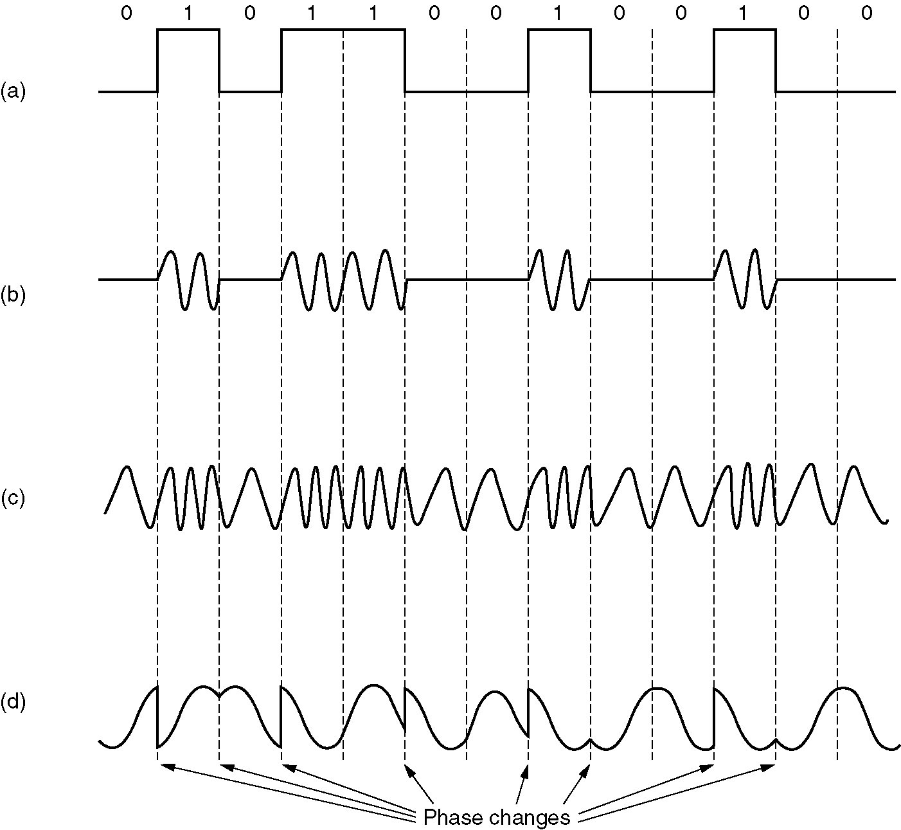
Forms of Digital Modulation
Input Signal
Amplitude Shift Keying
(ASK)
Frequency Shift Keying
(FSK)
Phase Shift Keying
(PSK)

Slide 50
Shannon’s Law
Shannon considered noisy channels and derived
C = B log (1 + S/N)
Gives us an upper bound on any channel’s performance regardless of signaling scheme
Old school modems approached this limit
B = 3000Hz, S/N = 30dB = 1000
C = 3000 x log(1001) =~ 30kbps
28.8Kbps – anyone remember dialup?

Slide 51
Clock Recovery
Using a training sequence to get receiver lined up
Send a few, known initial training bits
Adds inefficiency: only m data bits out of n transmitted
Need to combat clock drift as signal proceeds
Use transitions to keep clocks synched up
Question is, how often do we do this?
Quick and dirty every time: asynchronous coding
Spend a lot of effort to get it right, but amortize over lots of data: synchronous coding

